Slide 1
WELCOME
PERFORMANCE EVALUATION WORKSHOP
2022
Civil Service &
Academic Professional Positions

Slide 2
Performance Evaluation Workshop
2022 Evaluation Cycle
  Full evaluation period April 1, 2021– March 31, 2022
  Evaluations to be conducted beginning April 1, 2022
  Performance Evaluations forms due in Human Resources by June 3, 2022.

Slide 3
We’re Going Digital!
https://www.uis.edu/humanresources/evaluations/
The form will be initiated by the supervisor by clicking on the electronic form, choosing
“Official Annual Evaluation” and filling out the form. The form will then route to the employee for review and signature. It then routes back to the supervisor for approval and then to the Dean/Director for approval. Division Head approval is optional. Please consult with your Division Head to determine whether such approval is needed. Once all approvals are complete, the employee and all approvers will receive an electronic copy via email. Please review this email to make sure that the content of the evaluation is correct. An electronic copy will also be automatically routed to Human Resources to be placed in the employee’s personnel file.

Slide 4
These quotes were reportedly taken from actual federal employee performance evaluations:
“A room temperature I.Q. If he were any more stupid, he'd have to be watered twice a week.”
“His men would follow him anywhere, but only out of morbid curiosity.”
“Got a full six-pack, but lacks the plastic thingy to hold it all together.”
“Works well when under constant supervision and cornered like a rat in a trap.”
“Bright as Alaska in December.”
“When she opens her mouth, it seems that it is only to change feet.”
“He would be out of his depth in a parking lot puddle.”
“This young lady has delusions of adequacy.”
“Takes him 1 ½ hours to watch 60 minutes.”
“This employee should go far --- and the sooner he starts, the better.”

Slide 5
Avoid these types of counter-productive statements!
Written comments on the annual evaluation should be constructive.
Avoid insults or humor.
Never say anything that is or can be construed as discriminatory.

Slide 6

Performance Evaluation Workshop
Purpose of Evaluation:
Optimize Performance
    Continuous process
    Two-way process

Slide 7
Performance Evaluation Workshop
Purpose of Evaluation
Employee Development
Supervisor
      Framework
      Feedback
      Opportunity
      Reinforce
      Identify & correct
      Document performance

Slide 8

Performance Evaluation Workshop
Purpose of Evaluation
Employee Development (cont.)
Employee
      Job/Performance expectations
      Coaching
      Positive Reinforcement

Slide 9
Performance Evaluation Workshop
Provide continuous feedback
Pre-evaluation review by dept. head
Finalize evaluation
Establish goals, expectations, and standards
Self Evaluation
Evaluation interview

Slide 10
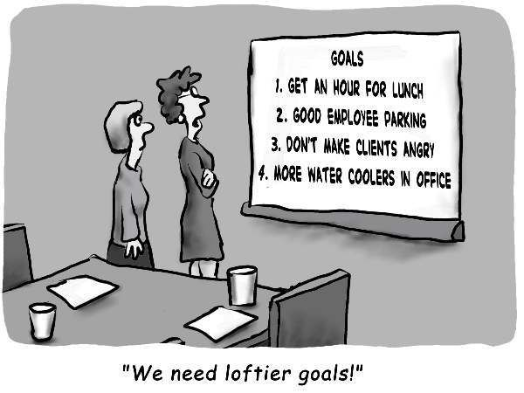
Performance Evaluation Workshop
Goal setting is completed as part of the annual evaluation process.
As you review accomplishments and performance for the previous period, you also set goals with the employee for the coming year.
What’s a goal? Specific statements that describe result to be achieved
SMART Goals
Specific
Measurable
Achievable
Results Oriented
Time Bound

Slide 11
Performance Evaluation Workshop
Examples of Unclear Goals:
Continue to work on cross-training manual.
Work toward becoming the MS Word expert for your work group.
Examples of Clear Goals:
Create a new cross-training manual by February 2023.
Become work group MS Word expert by attending at least 15 hours of training and provide a mini-training session to co- workers.

Slide 12
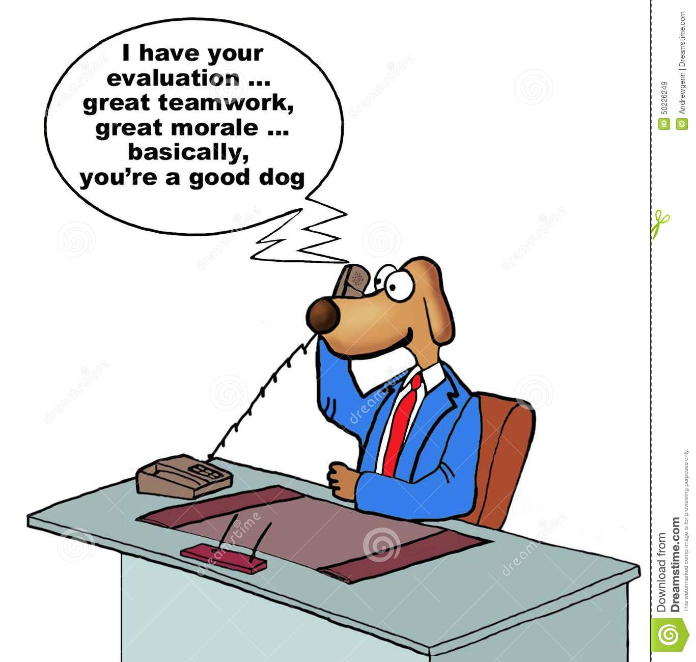
Performance Evaluation Workshop
Performance Factors

Slide 13
Performance Evaluation Workshop
Job Knowledge
  Demonstrates knowledge and skills necessary to perform the job effectively. Understands the expectations of the job and remains current regarding new developments, technologies, methods, theories, approaches, and processes in area of responsibility. Demonstrates initiative and a desire for improvement; seeks new ways to strengthen knowledge, skills, and abilities of self and others including ongoing professional development and training

Slide 14
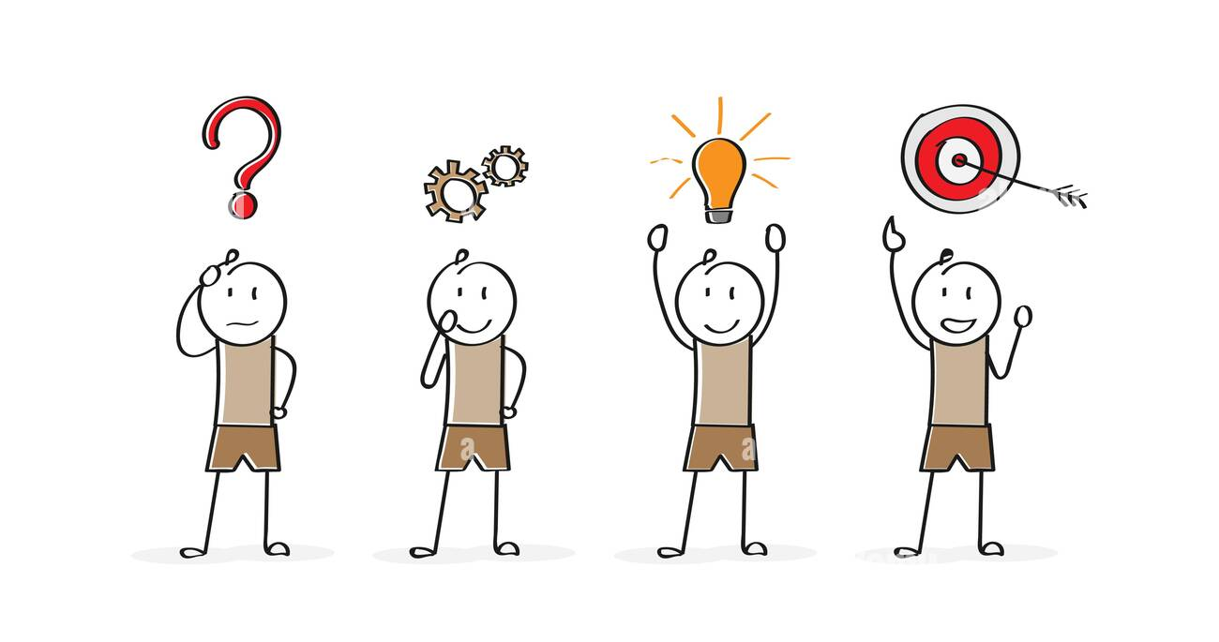
Performance Evaluation Workshop
Judgment and Decision Making
  Anticipates and identifies problems; proposes and evaluates alternative solutions. Demonstrates resourcefulness and creativity in solving problems and is open to new or different solutions. Follow up on problems and helps to bring about a resolution.

Slide 15
Performance Evaluation Workshop
Reliability and Commitment to the Job
  Meets the work schedule expectations of the position and provides advance notice for absence. Works efficiently; uses time effectively. Demonstrates flexibility and willingness to assist by taking on difficult or inconvenient responsibilities.

Slide 16

Performance Evaluation Workshop
Customer Service
  Listens to and understands the needs of the service recipient, whether inside or outside the University, and responds to those needs.

Slide 17
Performance Evaluation Workshop
Productivity and Quality of Work
  Delivers accurate and thorough work product in a way that reflects favorably upon the unit and the University. Completes an adequate volume of work and establishes appropriate priorities for fulfilling various job tasks.

Slide 18

Performance Evaluation Workshop
Communication
  Clearly, professionally and effectively conveys ideas and information in written and/or oral form.

Slide 19
Performance Evaluation Workshop
Teamwork, Cooperation and Interpersonal Skills
  Establishes and maintains effective working relationships with others. Responds to requests from others in a helpful manner. Works collaboratively and displays a positive attitude toward others.

Slide 20

Performance Evaluation Workshop
Diversity, Inclusion, and Creating Community
  Encourages diversity and inclusion in the workplace; engages in practices to foster a more inclusive working environment; actively engages in work to improve the University as a welcoming community; displays an open and inclusive attitude towards the campus community.

Slide 21
Performance Evaluation Workshop
Supervision and Leadership
  For supervisory staff: Provides effective leadership for subordinates and/or team, clearly communicates expectations, actively addresses and resolves problem; provides mentoring and guidance; provides constructive feedback to subordinates including the timely and accurate completion of annual and probationary evaluations.
  For non-supervisory staff: Sets a positive example for the campus community. Employee’s actions reflect well on the unit and the university.

Slide 22
Performance Evaluation Workshop
Strategic Compass Values [Student-focused Teaching and Learning; Integrity; Inquiry; Civic Engagement; Diversity; Strategic Thinking; and Accountability]
  Employee understands and acts in ways to advance the Strategic Compass values in his/her work and has contributed to the unit’s overall progress toward its Strategic Compass goals.

Slide 23
Performance Evaluation Workshop
Performance measures:
  Exceeds Expectations (4)
  Meets Expectations (3)
  Developing (2)
  Needs Improvement (1)
  Unacceptable (0)

Slide 24

Performance Evaluation Workshop
Preparing for Evaluations - Information Gathering
Notes from ongoing meetings, assignments, observations, list of accomplishments, and reflections during the year
Job Description
Individual’s Resume
Previous Performance Evaluations and projects, goals
Feedback from students/customers/co-workers/others
Letters of appreciation, planning meetings, performance discussions, professional development programs attended

Slide 25
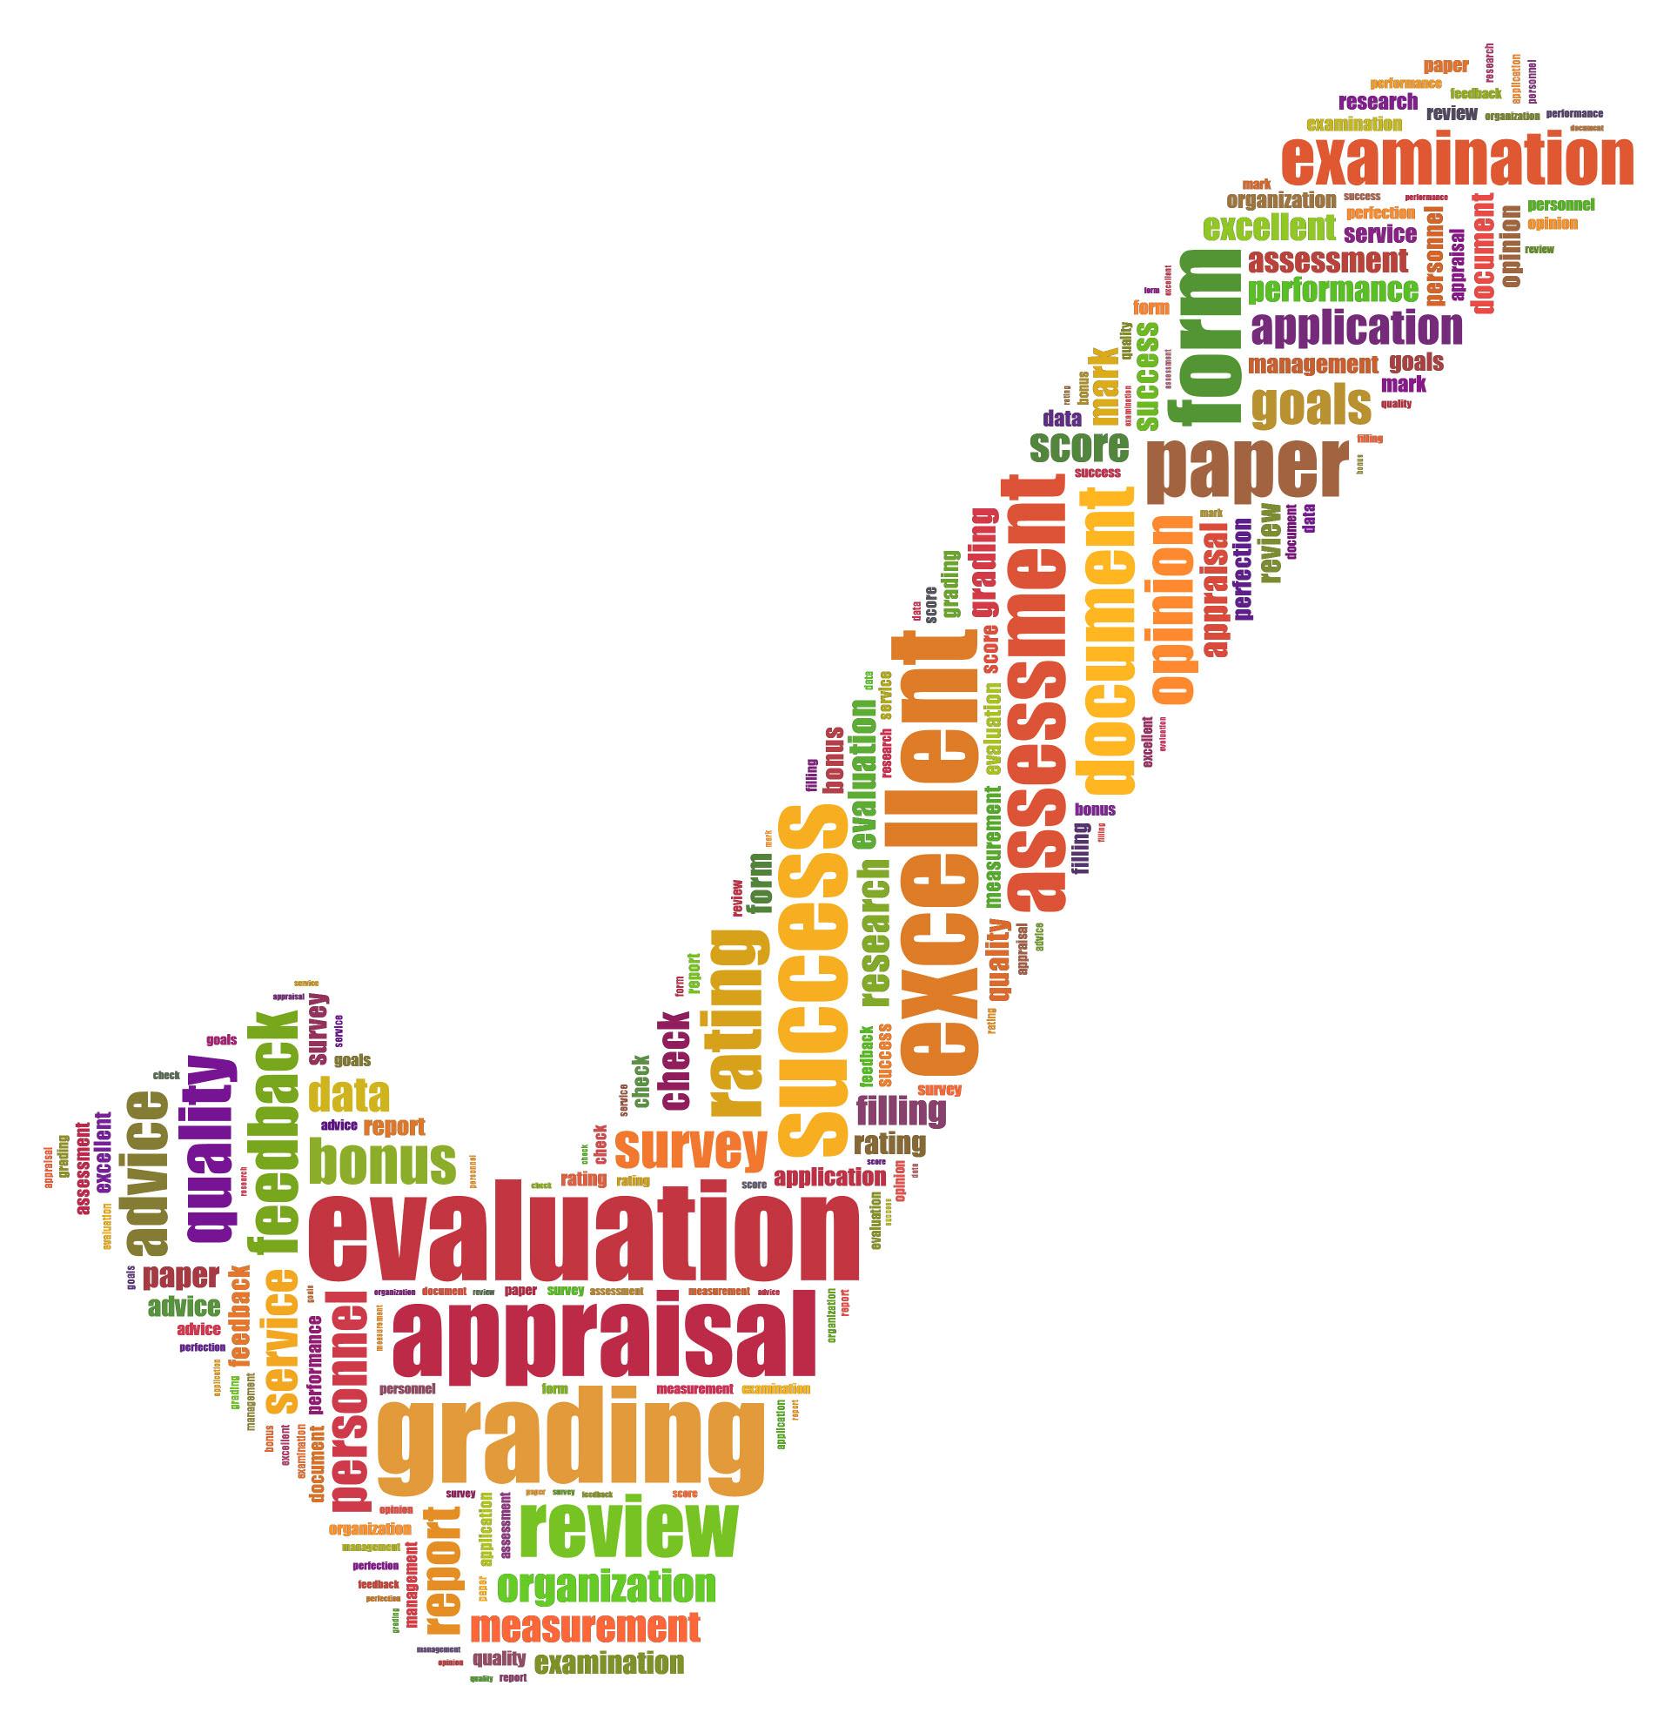
Performance Evaluation Workshop
Evaluation interview:
  Notify in advance
  Appropriate location and amount of time
  Employee Self Evaluation
  Review Self Evaluation prior to meeting
  Review Employee Performance Factors prior to meeting
  Discuss performance with your supervisor prior to meeting

Slide 26
Performance Evaluation Workshop
Evaluation interview (cont.)
  Discuss achievements, performance, and areas for improvement
  Review and discuss previous goals
  LISTEN, LISTEN, LISTEN
  Focus on job performance rather than non-job related factors
  Be specific with praise and criticism
  Not primarily for discipline or reprimand
  No surprises
  Develop goals for new year

Slide 27
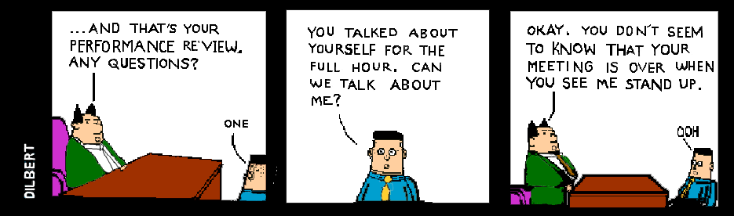

Slide 28
Performance Evaluation Workshop
Evaluation obstacles:
  Halo/horn effect – employee’s extreme competence in one area “shines” over others. Conversely, employee does poorly in one area and this overshadows all areas.
  Leniency/severity – supervisor is viewed as being too hard (severity) or too easy (leniency.)
  Central tendency – supervisor tends to rate everyone as a average.
  Just Like Me – being more favorable to people who are like you.
  Recency Effect – focusing on recent performance instead of entire year.
  Inflated rating – when supervisors use “satisfactory” as their lowest rating.

Slide 29
Performance Evaluation Workshop
  Next Steps in the Performance Management Process:
  Yes, It’s a Process
  Managing people means involvement in individual’s work performance and professional development
  Document and Communicate your observations with the employee – don’t wait for the performance appraisal!
  - Feedback on improvement areas and goals
  - Department needs and expectations
  - Professional Development opportunities
  - Recognition of progress and contributions
  -Annual Evaluations should not be used for disciplinary purposes

Slide 30
Performance Evaluation Workshop
Conclusion
  Performance Evaluation is a collaborative process.
  The goal is to provide specific feedback (good & bad) on job performance with the ultimate aim of IMPROVING PERFORMANCE and connecting individual performance to the University’s mission, vision, values and strategic initiatives.

Slide 31

Other Things to Know
The Annual Performance Evaluation cycle is a great time to review employee responsibilities and ensure the accuracy of all employee job descriptions.
Official copies of job descriptions are required for all employees at UIS bi-annually. For 2022, updated job descriptions will be submitted through JDXpert, a new software program for the collection and maintenance of job descriptions, which will go live on June 13th. More information on JDXpert will be sent to supervisors when available. Until then, please create a draft of any necessary changes to job duties and review with the employee during the annual evaluation process.

Slide 32
Job Description Review Basics
Job descriptions need to have percentages that are no less than 5% and no greater than 30% and adds up to 100%.
Appropriate signatures.
Correct job numbers (found in HRFE using employee’s name)
Current job description formats are on the web.
If you have changes or questions, call HR! ☺

Slide 33
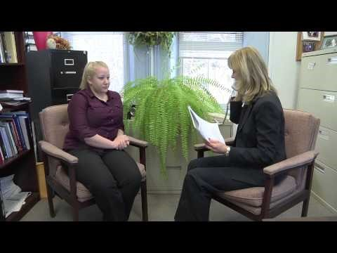
What Not To Do in a Performance Evaluation Interview

Slide 34
Questions?
Thanks For Attending!
Kenzie Westlake:
mwest22@uis.edu
Melisa Hatch:
mhat2@uis.edu
Melissa Mlynski: mmlyn2@uis.edu

