Slide 1

2024-25 FAFSA Updates
What You Need to Know About Financial Aid

Slide 2


Slide 3


The FAFSA Simplification Act was initiated as part of the Consolidated Appropriations Act of 2021. It means significant changes to the application and awarding process, starting with the 2024-25 Free Application for Federal Student Aid (FAFSA).

Slide 4

Major FAFSA Changes
Here’s what you need to know:
Student Aid Index (SAI) replaces the Expected Family Contribution (EFC) – this is a measurement used to determine aid eligibility.
Federal Pell Grant eligibility will expand to more students.
Federal tax information is transmitted directly from the IRS.
The number of college students in the family no longer considered.
Details such as net worth of farms (excluding primary residences) and small businesses are now required to be reported.
Tax filers are required to provide consent to retrieve tax data from the IRS.
Updates and details available on StudentAid.Gov

Slide 5
Steps to complete the FAFSA
Create or Confirm your StudentAid.gov account (formerly FSA ID)
Complete the Student section of the FAFSA.
Indicate any contributors (usually parents or a spouse) to your FAFSA.
Contributors will receive an email invitation to your FAFSA.
Contributors complete their section of the FAFSA (within 45 days).
*Ensure all parties sign electronically and submit*
Once the FAFSA is submitted and processed, you should receive an email confirmation from FSA.

Slide 6
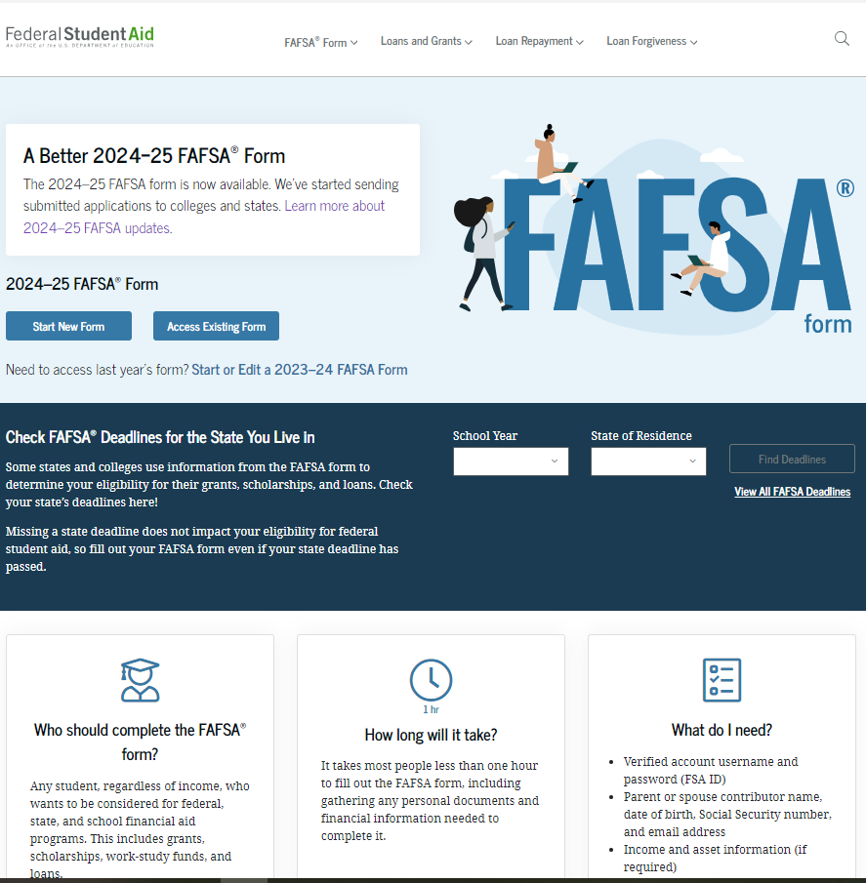
Submit the FAFSA, if you have not already.
Most students complete the form in minutes, not hours!
StudentAid.gov

Slide 7
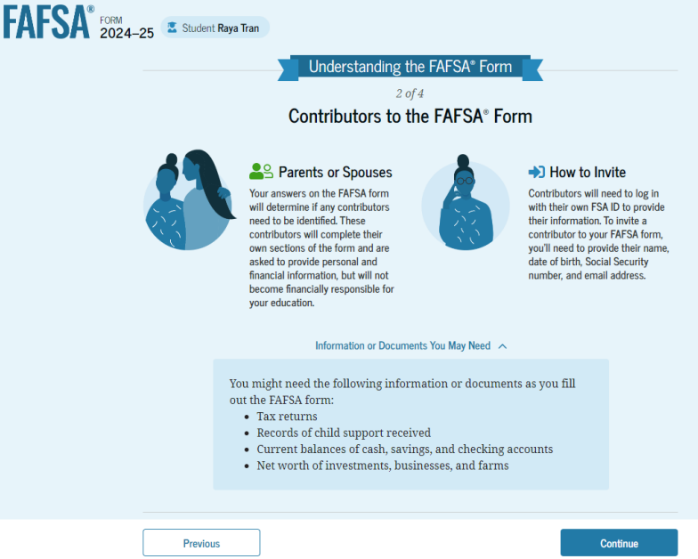
FAFSA Contributors
Most dependent students must list a parent or parents as contributors
If you are not sure who to invite to your FAFSA, there is an easy wizard in the form to help you.

Slide 8
What to Expect Next
Current Technical Issues
Certain student populations may be unable to submit or make corrections.
Technical known errors for students making corrections to a submitted FAFSA.
Current Issue Alerts webpage
https://fsapartners.ed.gov/knowledge-center/topics/fafsa-simplification-information/2024-25-fafsa-issue-alerts
Timeline
Dec 30- FAFSA released
Mid-March- FAFSA applications processed, and data sent to schools
Late March- several errors identified in determining student eligibility
April 15- FAFSA corrections open to students
Delayed timeline for aid offers from UIS- expected to be available in May
Watch for communications from UIS Financial Aid for updates.

Slide 9
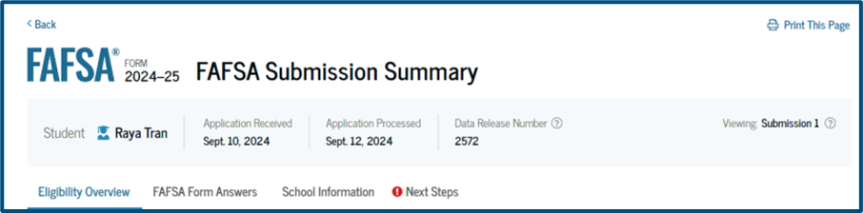

FAFSA Submission Summary
Eligibility Overview
FAFSA Form Answers
School Information
Next Steps
Ability to print summary
Ability to make corrections is available.
Some common mistakes:
-Missing signature(s)
-Incorrect answer to Unsub only question/parent data missing

Slide 10
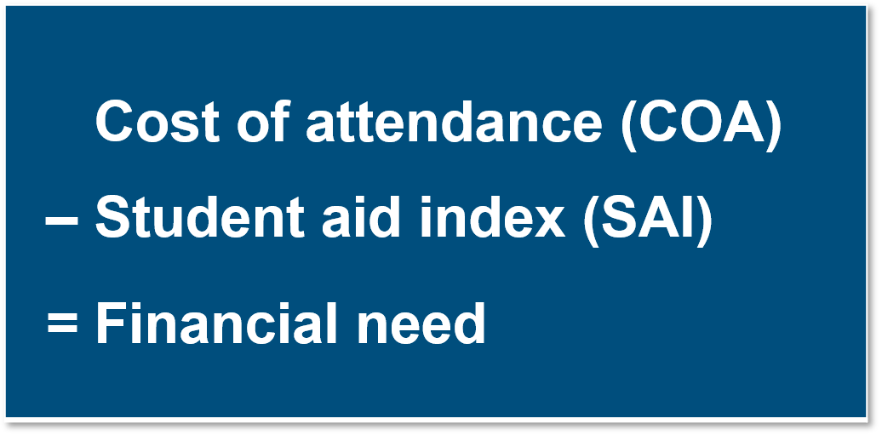
Aid Offer Information
What is the Student Aid Index (SAI)?
Number resulting from the evaluation of the student’s (and family) approximate financial resources
Student Contribution
+
Parent Contribution (Dependent Students)

Slide 11
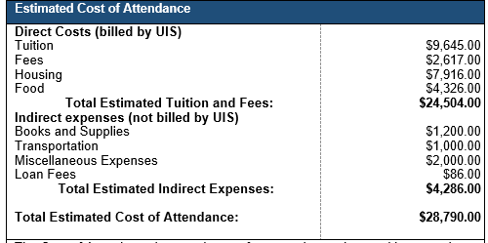
Aid Offer Examples
Freshman, On-Campus, IL Resident
High academics
High financial need

Slide 12
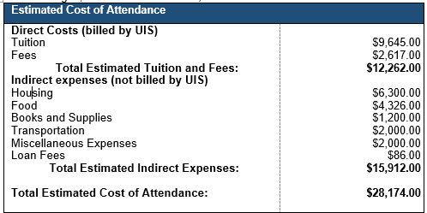
Aid Offer Examples
Transfer, Off-Campus, IL Resident
Average academics
Some financial need

Slide 13

Tips and Reminders
Net Price Calculator- www.uis.edu/financial-aid/cost-attendance/net-price-calculator
UIS FAFSA Simplification page- go.uis.edu/fafsasimplification
Visit New Student Information
go.uis.edu/FinancialAidNewStudentInformation
Contact UIS Financial Aid for assistance or to set up an individual appointment.
go.uis.edu/finaid

Slide 14

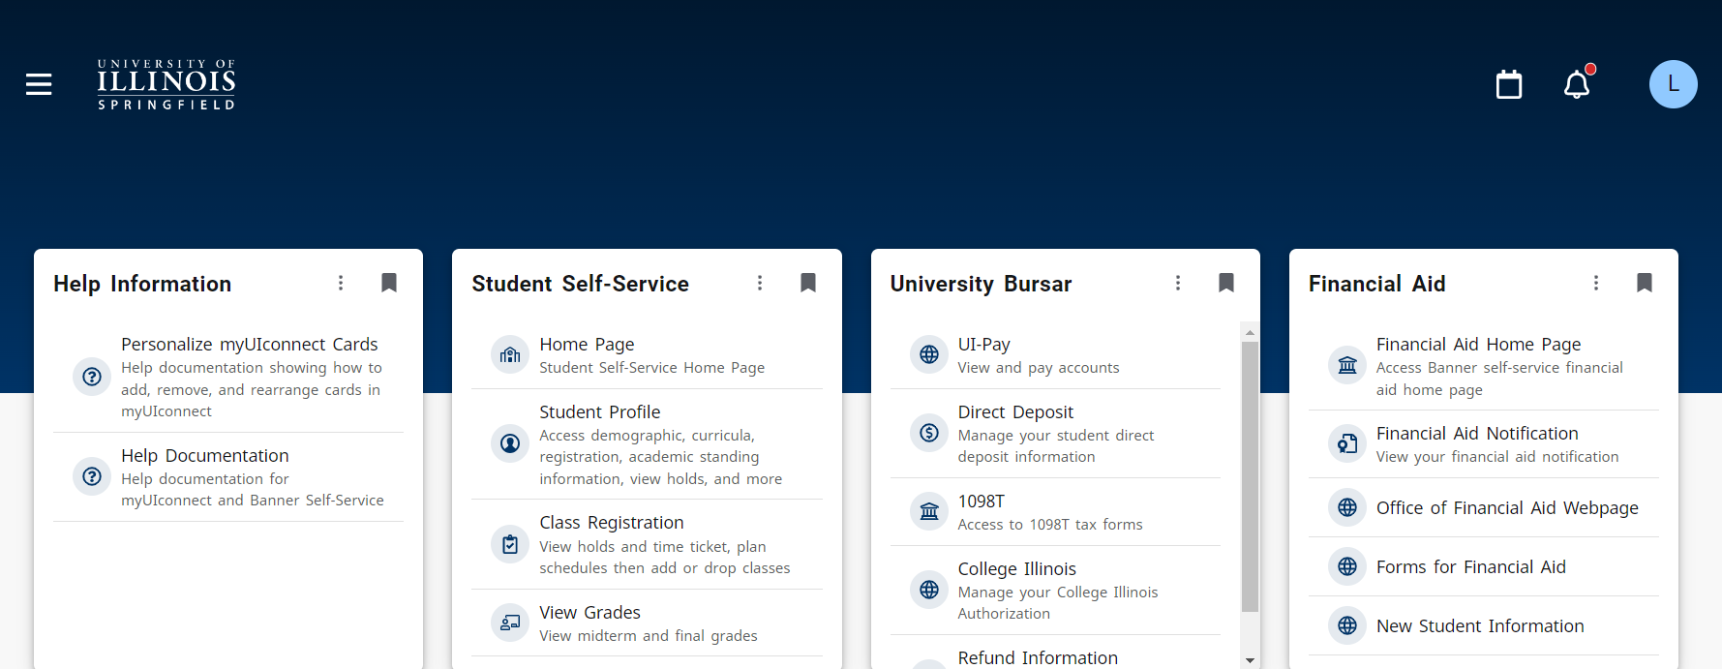
UIS Self-Service Experience
Subtitle / Text

Slide 15
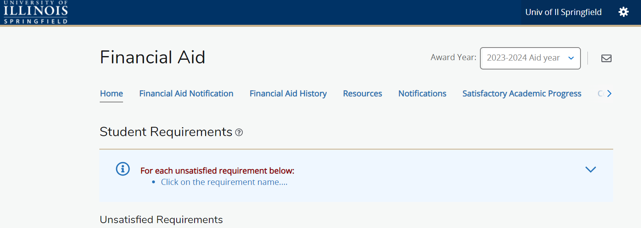
Self-Service Financial Aid

Slide 16

Questions?
Contact UIS Financial Aid
Ph 217-206-6724
Email finaid@uis.edu
Set up an appointment:
go.uis.edu/contactFA

