Slide 1
CAP STUDIOs
Presented by Shelby Karch

Slide 2

Who we are
The central mission of CAP Studios is to offer students a safe and comfortable environment where they can receive personalized assistance on their writing assignments. Our peer tutors have experience working with writers at all stages of the writing process—from drafting a thesis statement to revising a final draft.
Notes:
Peer is emphasized here, they have experienced this class before,

Slide 3
What we do…
Review
Review assignment guidelines and listen to student concerns in order to provide helpful feedback
Help
Help students understand a concept or a specific topic
Assist
Assist with all stages of the writing process, including brainstorming, planning, drafting, and revising
Encourage
Encourage students to formulate and develop their own ideas
Point
Point students to additional resources related to their major, course, or assignment
Notes:
Hey I don’t know how to write a thesis statement and the tutor will walk you through that thought process

Slide 4
What we don’t do…
Proofread or edit essays
Guarantee that students will master the material
Speculate about what grade a student might receive
Critique, criticize, or talk in any other way about instructors or their grading practices
Provide last-minute solutions to poor time management
Offer advice on non-academic matters
Notes:
This is really important.
Do not review grammar or edit papers.
Onus is on student and instructor to understand the content
The tutor is not grading you at the end of the day and wont tell them about the teachers grading system
Helps to prevent procrastination,
Can help with study habits, but not on non academic matters

Slide 5

What can you expect from a CAP Studios session?
Introductions and an inquiry about your visit
Review the prompt, assignment, and any other supporting documents
Identify what YOU want to work on and focus on Higher Order Concerns (HOC)
Stick to your appointment time (either 30 or 60 minutes)
Receive a recap of what you worked on and what still needs to be done. If time permits, produce a revision plan.
If necessary, book a follow-up appointment
Notes:
CAP Studio appointments are synchronous, which means you and your tutor will work together, at the same time, via Zoom.
Not necessary to upload assignment description or rubric because I am the TA for this class and will have that available already
Preface that only I do in person meetings everyone else is online
HOC are higher level problems like thesis statements and such
If u have time u can book a follow up appt

Slide 6
CAP Studios Forms
Client Report Form (to be filled out by the tutor within 24 hours of your appointment)
CAP Studios Student Survey (to be filled out by the tutee within 24 hours of receiving client report form)
Notes:
They need to submit copy of that form to canvas to prove that went
Important for feedback and they take it seriously so we can modify our practices to help best
Helps us vote for tutor of the year
If they were kind and empathetic or dutiful and responsive let us know

Slide 7
For Future Reference…
Continuum
Continuum, the Capital Scholars Honors Journal, is one of academic and artistic scholarship managed and edited by students of the Capital Scholars Honors Program at the University of Illinois Springfield. Continuum is published once per academic year and showcases the creative and intellectual talent of the Honors Program student body.

Slide 8
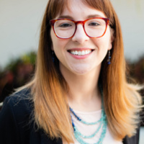
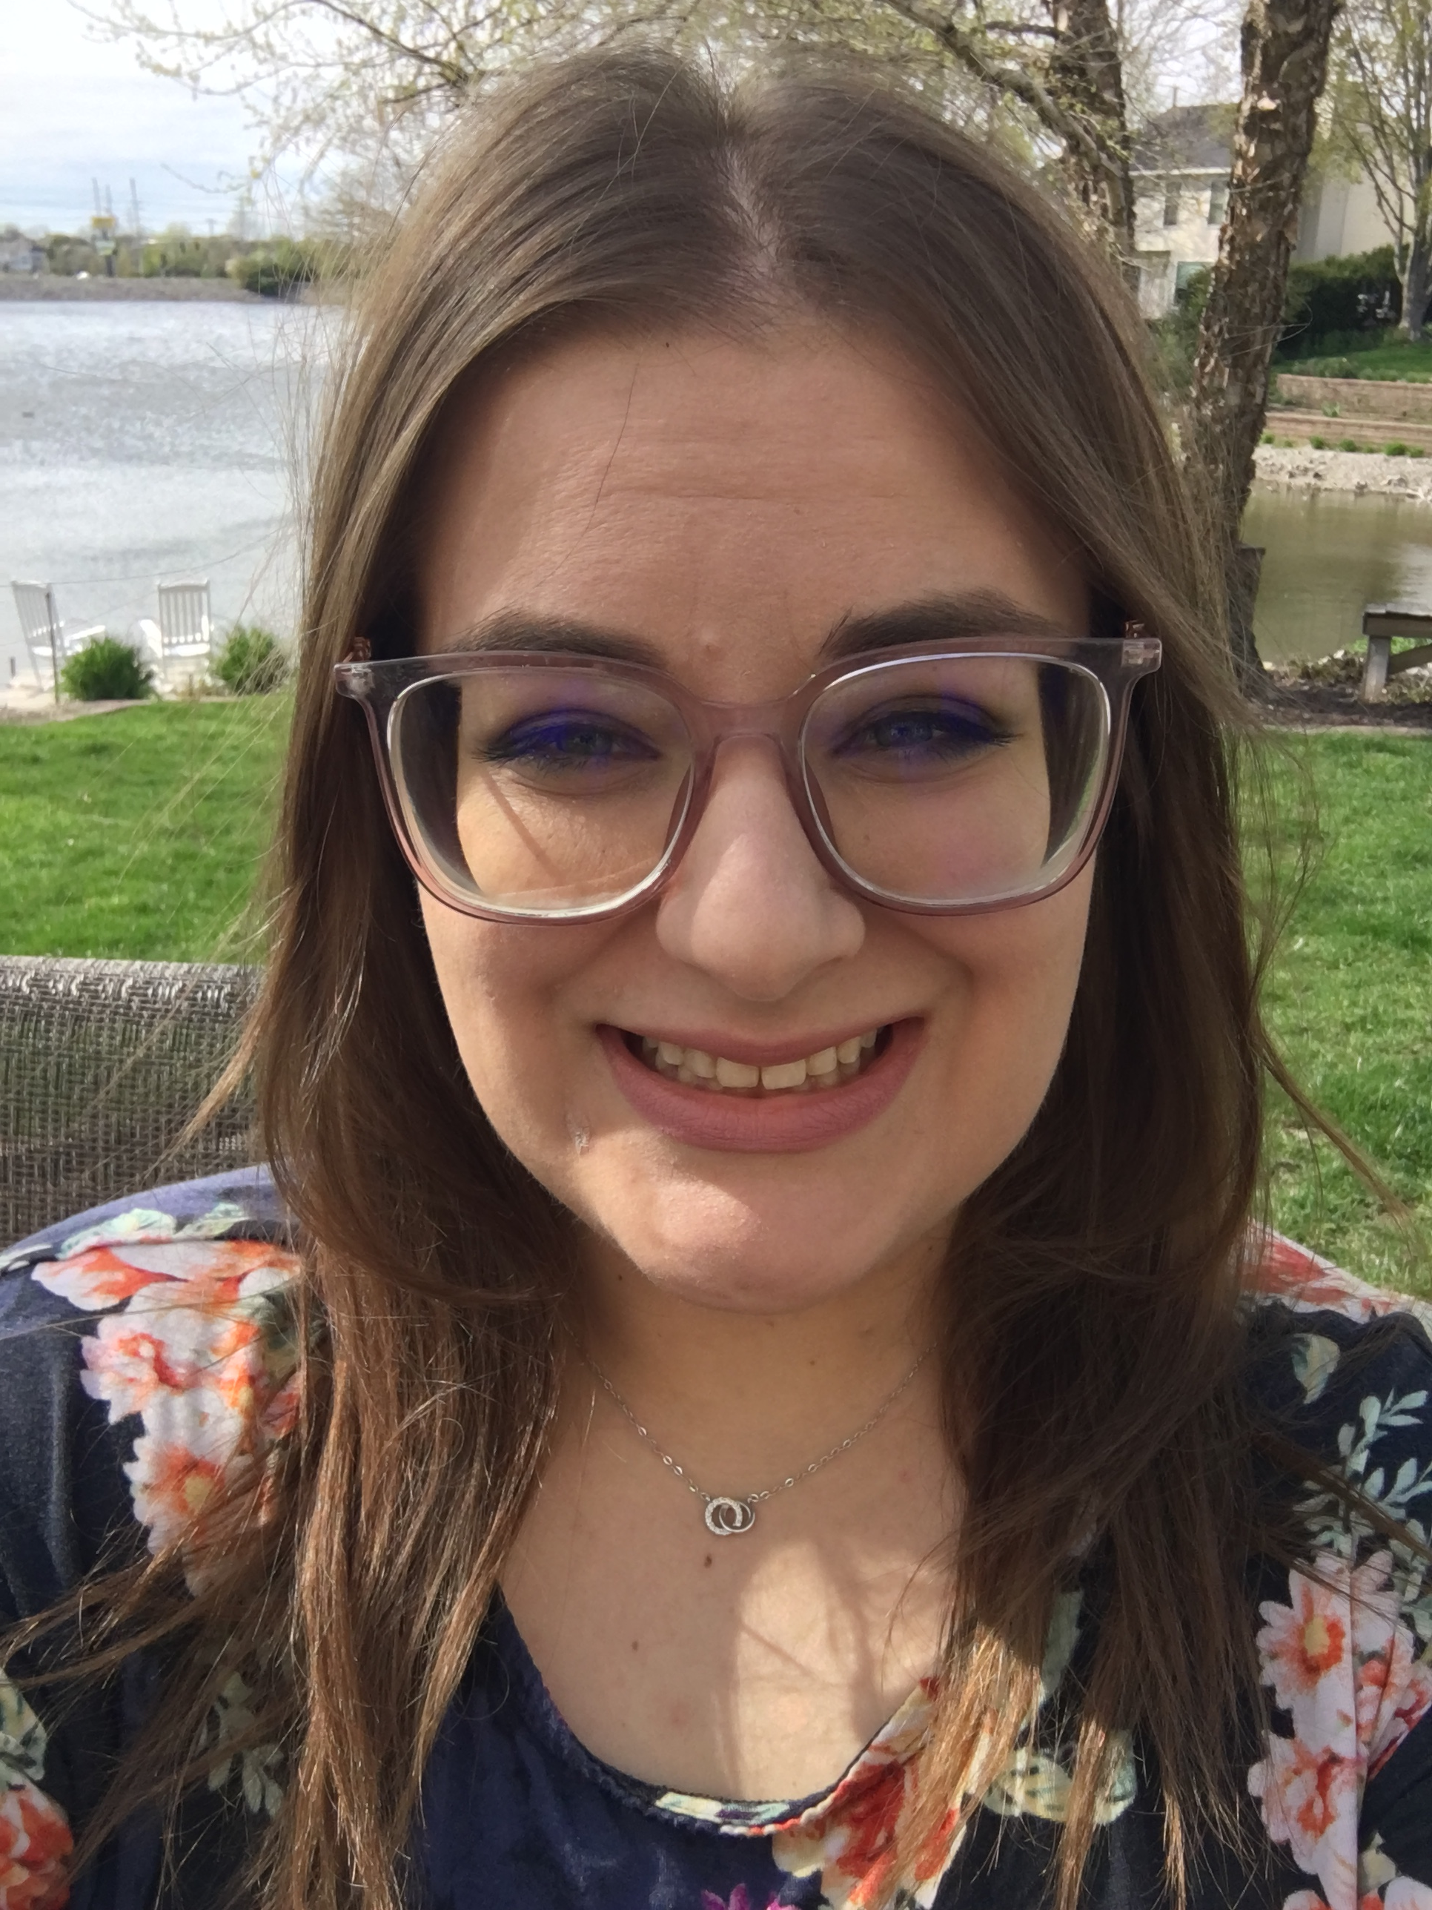
People to know
Diana Dabek, Coordinator of Honors Composition and Peer Tutoring (ddabe2@uis.edu)
Shelby Karch, Peer Tutoring Teaching Assistant (skarc2@uis.edu)
Notes:
Then go to the word doc that walks them thru
HAVE to use UIS email or it will not work
Put 2025 for graduation year and can change manually later
Look at tutors information, like deciding between two for same time, click on their names to get their bio info and times available
Once selected, fill in course number and instructor, then describe your general help u might need, then upload the files,
Then get email confirmation
HAVE to book appointment 24 hours in advance so we can look over the content before hand, each tutor has a zoom link in bio and so u copy and paste the zoom link
Always can email diana dabek about probs there may be

