Slide 1
Interaction in the Online Classroom
Illinois Online Network

Slide 2
Why Interact Online?
Necessary for successful online courses
Direct transfer of face-to-face course to online doesn’t provide adequate communication

Slide 3
Why Interact Online?
“Students need to gain a deep understanding of the opposing facts, theories, and points of view. The worst way to do this is to give a lecture; the best way is a debate, especially one tha tcontinues over a period of time, enabling students to pursue and present additional information to support their positions.”
Harasim, L., et al. (1995). Learning Networks : a Field Guide toTeaching and Learning Online. Cambridge, Mass.: MIT Press

Slide 4
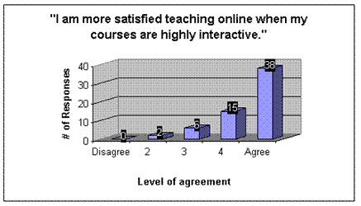
Faculty Satisfaction Increases

Slide 5
Interaction
So easy not to do (well)
So easy to misinterpret

Slide 6
Types of Interactions
Instructor – student
Instructor - class
Student – student
Student – class
Instructor – small groups

Slide 7
Technology For Interactions
Asynchronous conferencing(discussion boards, or discussions)
Participants communicate by writing
Messages are kept on a central server
Participants can write messages anytime from any place
Participants can read messages and respond any time

Slide 8
Technology for Interactions
Synchronous conferencing (chat)
All participants must be online at the same time
Communication is mostly by writing, but sometimes by audio

Slide 9
Difficulties with Interacting Online
Faculty do not understand how to communicate effectively online
Students are reluctant to communicate in writing
Overcoming reluctance on both sides is key

Slide 10
Plan Before Course Begins
Think carefully about how interactions will occur
Don’t add a discussion component to your course without planning to use it
Consider how students will be evaluated for contributing to the online discussion

