Slide 1
What is OER?
Why is it Important?
H. Stephen McMinn

Slide 2
Outline
Definitions
Background and Related Initiatives
Why – Depends on Who
  Administration – Higher Education – Society - Students – Librarians - Faculty
What you can do?
Help!

Slide 3
OER (Open Educational Resources) -
Definition
Many with subtle differences….
  "teaching, learning and research materials in any medium, digital or otherwise, that reside in the public domain or have been released under an open license that permits no-cost access, use, adaptation and redistribution by others with no or limited restrictions.“ – UNSCO
Open Education as a movement – An effort by faculty and educators to use freely available, licensed, or low cost educational resources to ensure that all students have the ability to be successful.

Slide 4
/or OE – Open Education
The Open Education Movement is not just about cost savings and easy access to openly licensed content; it’s about participation and co-creation.
OEP - Open Educational Practice (OEP) is the use of open or supplied educational resources for teaching and learning in order to innovate the learning process. They are represented in teaching techniques that draw upon open technologies and high-quality available or open educational resources (OER) in order to facilitate collaborative and flexible learning. They may also involve students participating in online, peer production communities within activities intended to support learning.
Open Education can encompass ---
  • Open textbooks • Open licensing • Open assessment practices • Open badges
  • Open online courses • MOOCs (debatably) • Open data • Open standards
  • Open Access scholarly works • Open source software • Open educational resources

Slide 5
Not New ….
Related Concepts/Initiatives
Learning Repositories
  ERIC
  Merlot
Conferences
Sharing and Equality are Core Values in Education/Libraries
Term OER was coined over 15 years ago
Open Textbooks - OER
Open Access – OA
Electronic Archives – Digitization Projects
Institutional Repositories (IR) - IDEALS
Creative Commons Licensing
Copyright
Notes:
2017 • 15 year anniversary of the term “Open Educational Resources” • 10 year anniversary of the Cape Town Open Education Declaration • 5 year anniversary of the Paris OER Declaration • Year of Open

Slide 6
Why Open? – Administration or Higher Education Perspective
Facilitates the free exchange of information.
Allows higher education to take ownership of its content.
Empowers faculty.
Sharing is scalable.

Slide 7

“…higher education shall be equally accessible to all”

Slide 8
Cost of Higher Education
The cost barrier kept
2.4 million
low and moderate-income, college-qualified high school graduates from completing college in the previous decade.
The average borrower owes more than
$28,699
in student loans (class of 2016).
Illinois = $29,271
UIS Cares Food Pantry: Free resources for all currently enrolled UIS students
The UIS Cares Food Pantry opened on campus in the fall 2016 semester after individuals inquired about providing food options to students struggling with food insecurity. After years of brainstorming and attempting several variations to tackle this issue, the UIS Cares Food Pantry was born.

Slide 9
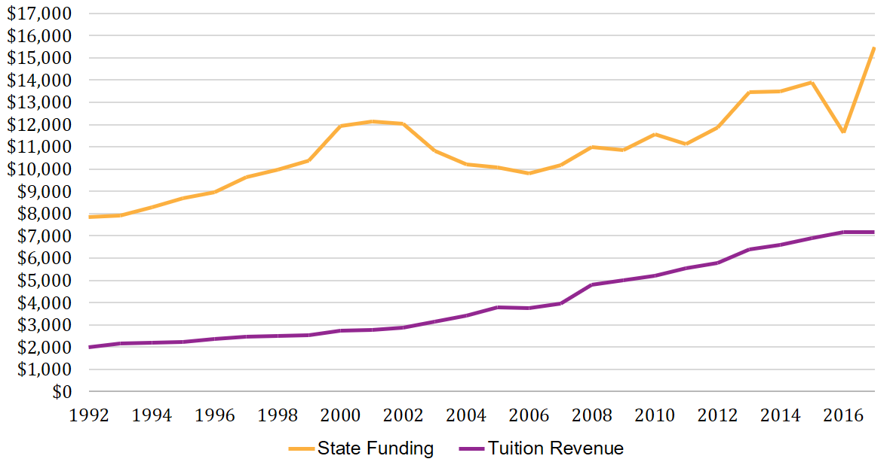
Illinois Higher Education Funding - $/FTE
Notes:
Compare the proportion of cost that students must contribute in 1989 to today.

Slide 10
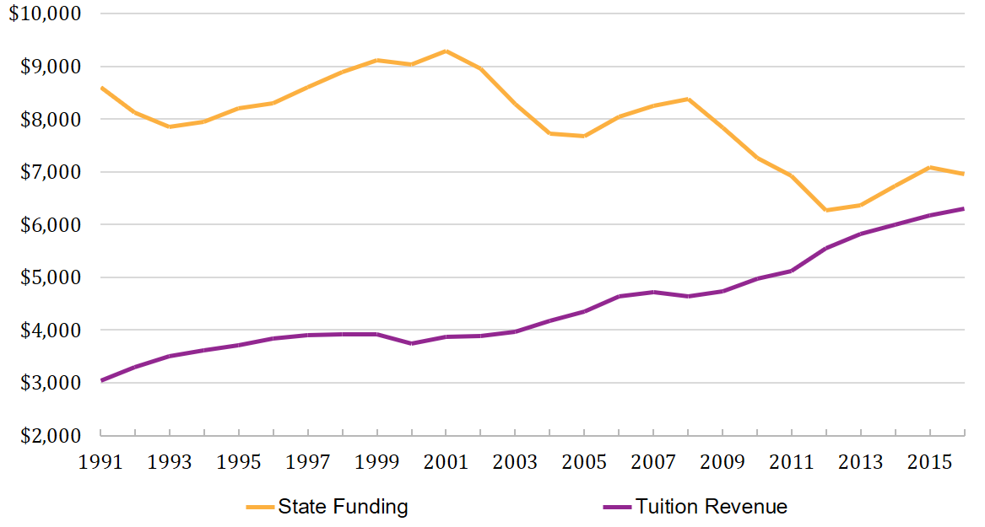
US Higher Education Funding - $/FTE
Notes:
Compare the proportion of cost that students must contribute in 1989 to today.

Slide 11
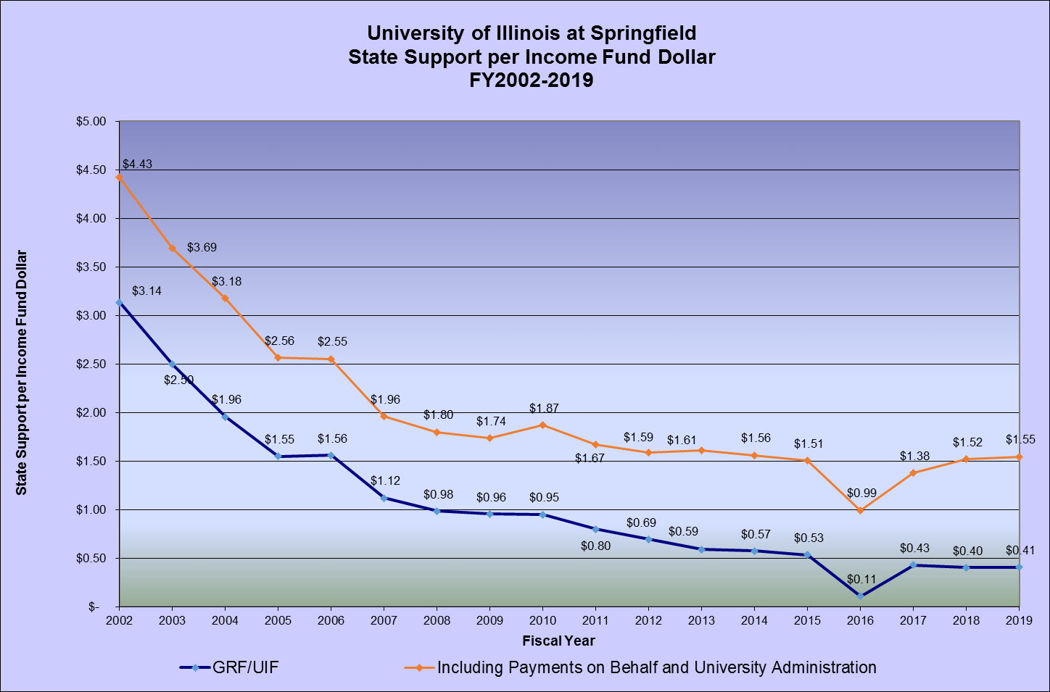
UIS State Support per Income Fund Dollar

Slide 12
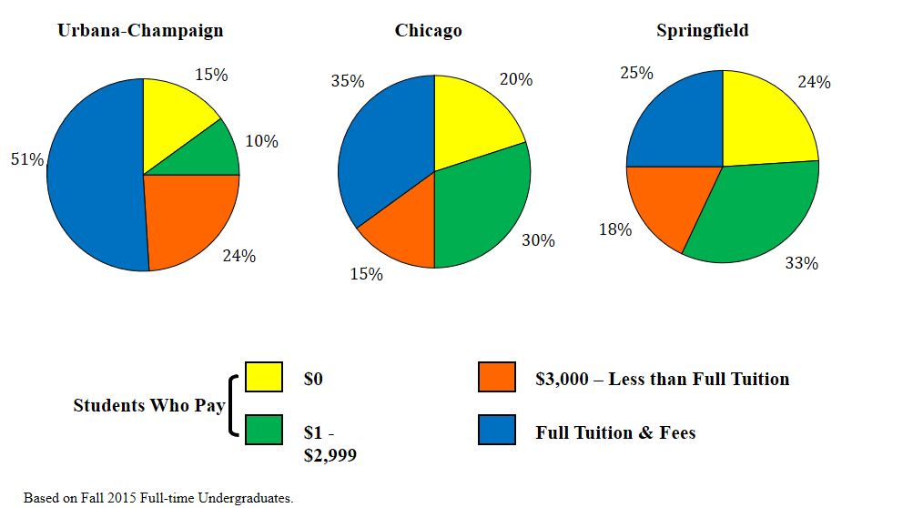
University of Illinois
Almost half of Full-time Undergraduate Students pay less than full tuition price
Fall 2015 – All Students

Slide 13
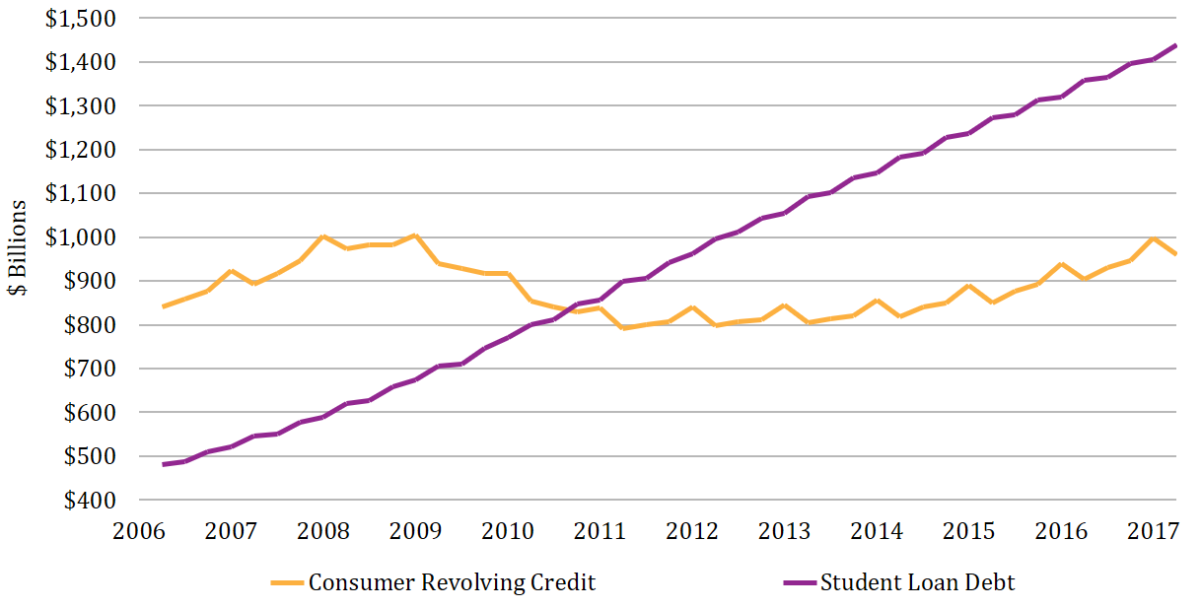
US Debt
Federal Reserve

Slide 14
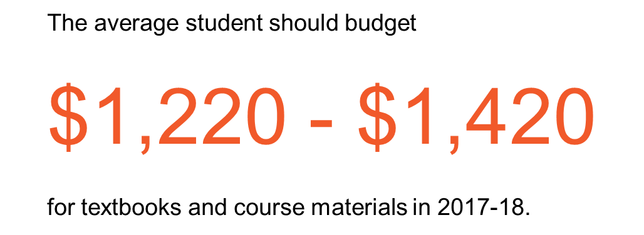
Cost of Textbooks
Nationally
Illinois
Average of Illinois Institutions
$1,324

Slide 15
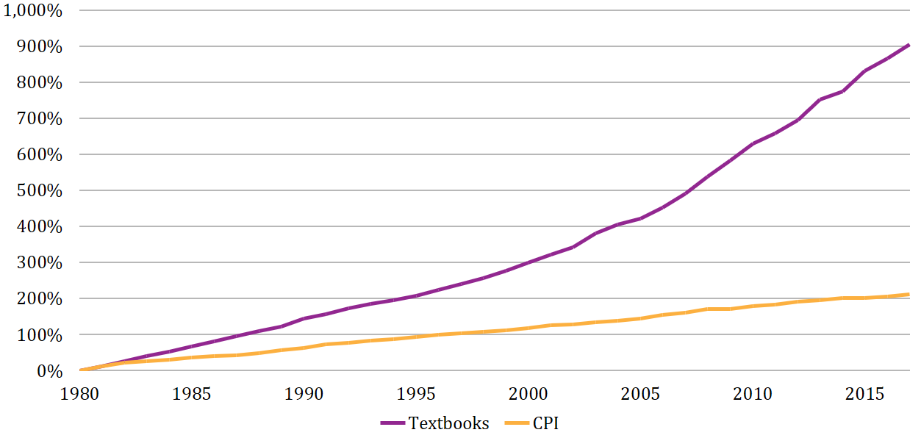
Increase in Textbook Prices
Notes:
The cost of textbooks has risen 3-4x time the rate of inflation (CPI = Consumer Price Index (shows inflation))

Slide 16
Students - Coping with the Cost
Purchase an older edition of the textbook
Delay purchasing the textbook
Never purchase the textbook
Share the textbook with other students
Download textbook from the internet
Notes:
This section explores the ways students cope with the high costs and the academic risk, and the academic impact that those actions have.

Slide 17
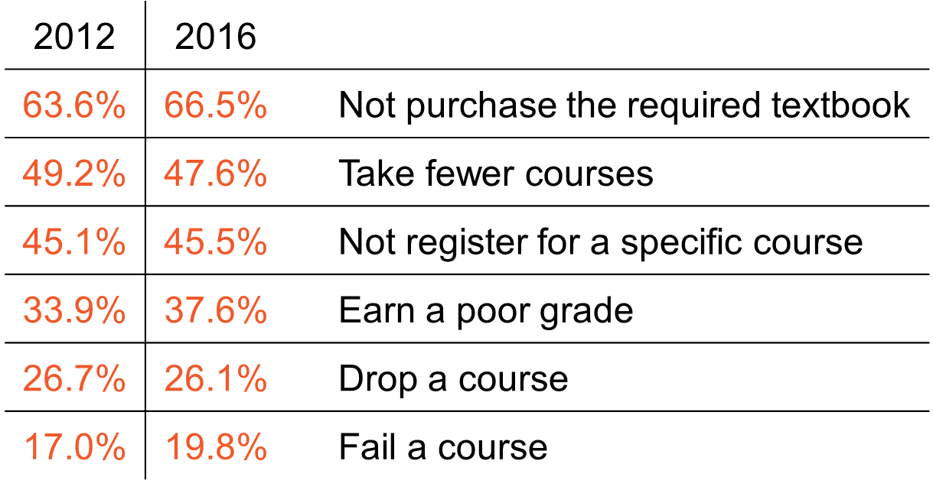
Some Facts/Student Surveys*….
Q: In your academic career, has the cost of required textbooks caused you to:
Student Textbook Survey

Slide 18
What can we do?
Tuition and Fees
Room and Board
Books and Supplies
Personal Expenses
Transportation
Notes:
Admit that it’s not the highest cost leading to these affordability issues – but it is:
the one cost that we as faculty can impact
it has a special impact on the academic success of students (as we’ll see later)

Slide 19
Why OE – Library Perspective
Opportunities to partner with Faculty
Better understanding of the discipline/topic
Increased use of Library Resources
Faculty appreciate the library as a service unit not a materials/book warehouse
Opportunities to support students as they create information, not just be consumers
Help students achieve academic success!

Slide 20
Comparison of Types of Educational Materials
Type of Material | Cost to Students | Permissions to Faculty and Students
Commercial Textbooks | Expensive | Restrictive
Library Resources | Free | Limited Permission
Website | Free | Limited Permission
Open Educational Resources | Free | Varies by CC License

Slide 21
Why OE – Faculty Perspective
Ensure that course materials align with learning objectives
Often times OER materials are more current or topical which helps with student engagement and interest
Assists with new teaching methods – flipped classrooms, active learning, etc.
Reduce causes for students to not acquire or access assigned educational resources
Helps fill seats – OER classes are attractive to students
You want your students to be successful!

Slide 22
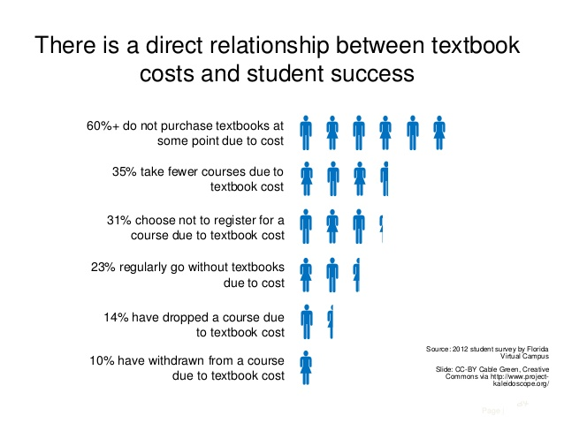
Correlates to ….
More credit hours taken
Less repeating of courses
Faster time to graduation
Higher graduation rates
Higher students satisfaction
Better course work is always easier to grade

Slide 23
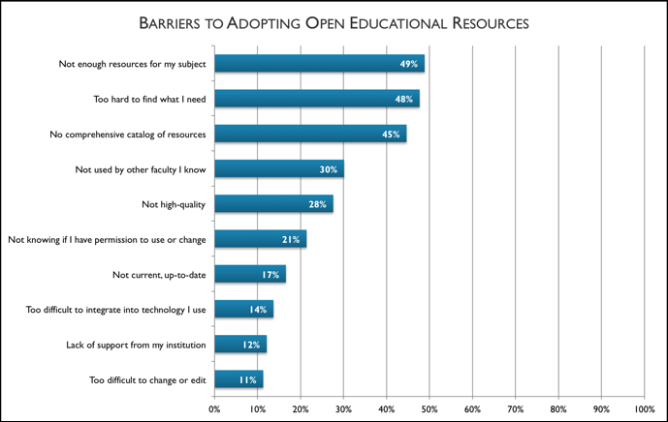

Slide 24
Barriers to Faculty Adoption
Lack of Awareness –
  Unsure what open textbooks are - Unaware that open textbooks are a viable option
  Understanding the urgency of student financial stress, and how it impacts students academically
  Confusion between open textbooks and electronic textbooks
Time Constraints –
  Where to find open textbooks
  Lack of time to search OE textbooks, revamp courses and assignments
  Limited time to engage in reviewing open textbooks
Quality Concerns –
  Skepticism of the quality of open textbooks
  Believe that current resources serve the need, despite the expense

Slide 25
Answers to Overcoming Barriers
Awareness –
  Attend training or workshops on OE - You are here!!!!
  Librarians/COLRS/OER Faculty Fellows – Happy to help
Time
  Librarians can assist with locating scholarly materials (books, journals, databases..) – It’s what we do
  Open Textbook Network
  Intellus
Quality Issues
  Open Textbooks come from (1) Funded initiatives – universities, foundations, governments, institutional consortia(2) Independent authors (3) Discipline collectives (4) Other
  Reviews/Ratings
  Your choice/Your evaluation!

Slide 26
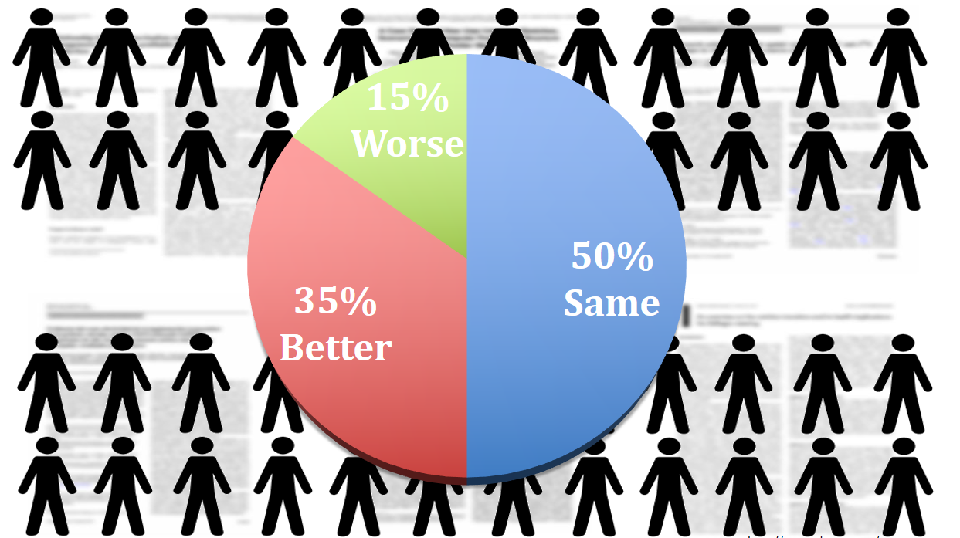
Pie Chart
opened group

Slide 27
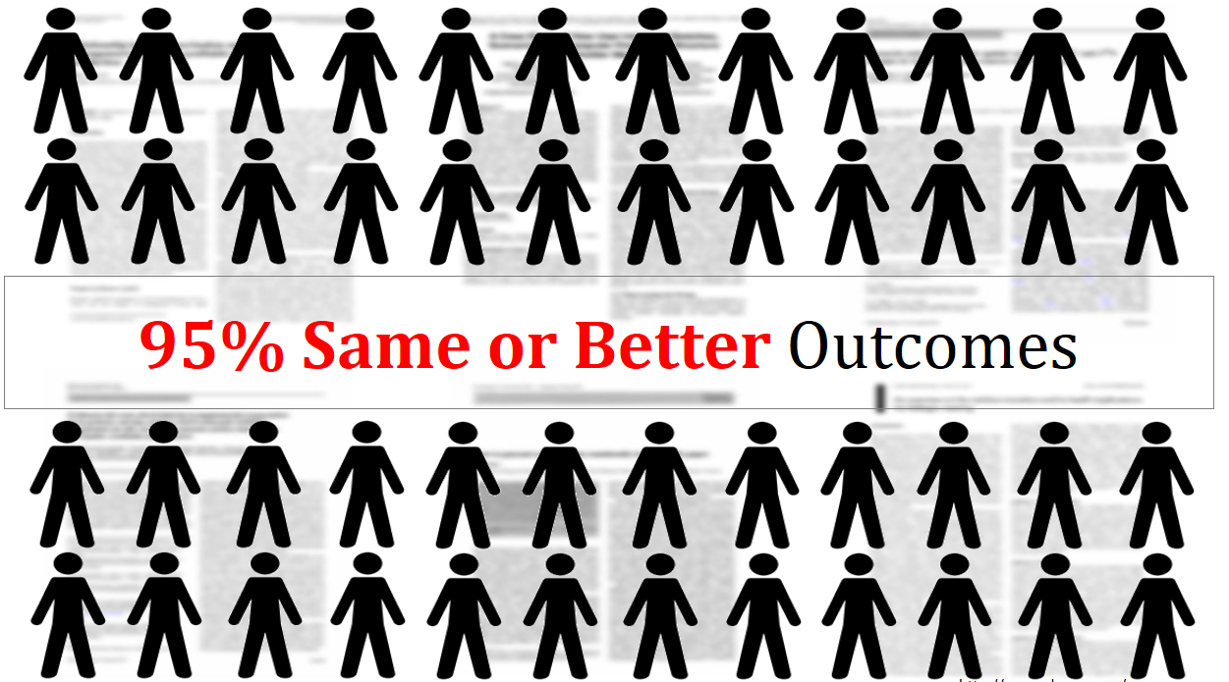
95% Same or Better Outcomes
opened group

Slide 28
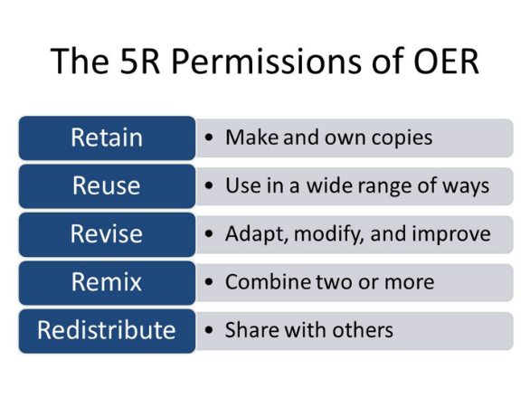
Why/What is Open?
“Open” describes any copyrightable work that is licensed, usually through Creative Commons Licensing, in a manner that provides users with free and perpetual permission to engage in any of the “5R” activities:
Retain - the right to make, own, and control copies of the content (e.g., download, duplicate, store, and manage)
Reuse - the right to use the content in a wide range of ways (e.g., in a class, in a study group, on a website, in a video)
Revise - the right to adapt, adjust, modify, or alter the content itself (e.g., translate the content into another language)
Remix - the right to combine the original or revised content with other material to create something new (e.g., incorporate the content into a mashup)
Redistribute - the right to share copies of the original content, your revisions, or your remixes with others (e.g., give a copy of the content to a friend)

Slide 29
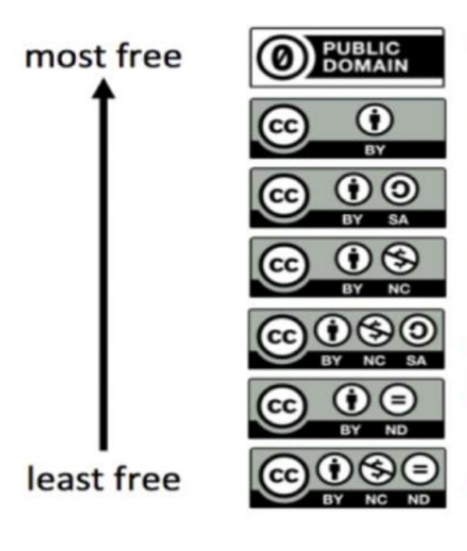
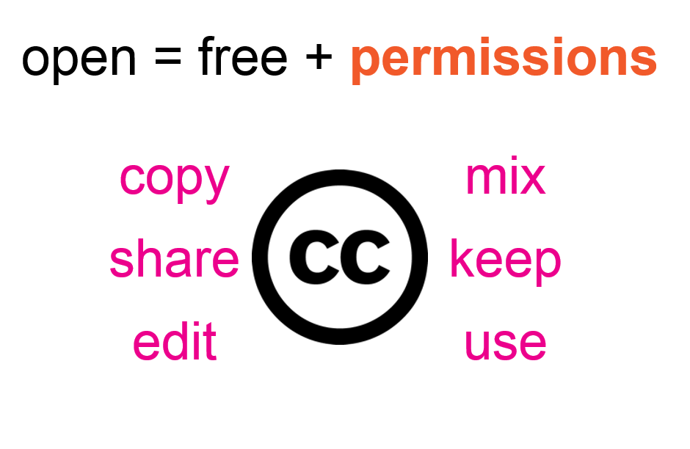
With Creative Commons licenses, you are free to…

Slide 30
What Can You Do?
Consider using OER
Look at available Open Textbooks
Attend Workshops on….
  Intellus
  Open Textbook Network (OTN)
  Copyright and Sharing Library Resources
Ask a Librarian/COLRS staff/Colleague

Slide 31
Methods/Options for Adoption
Open Textbooks
  Faculty & Students know textbooks, Plus - how to evaluate/adopt
  Major pain point for students
OER Resources – Learning Object Repositories
Videos - YouTube
Library Licensed Resources – EBooks, Videos/Video Databases, Journal Articles, etc. Course Reserves via Fair Use
Government Documents/Data
Open Access Resources – primarily articles although more books and book chapters
Request that Brookens Library purchase materials or electronic versions for the student

Slide 32
Help - Library Support
  Help with Information Literacy Objectives/Instruction
  Course Reserves for Faculty and Students
  Purchase E-Books with multiple users
  Navigating Copyright/Creative Commons Licensing
  Finding Information OER/Library Resources/OA Resources – It’s one of the big things we do?

Slide 33
Help – COLRS/ITS
Accessibility Support and Guidance
Blackboard Support
Course Design Support
Support with Teaching Methodologies
Technological Support - Help with Word, PDF, Web, PPT, etc.
OER Fellows program

Slide 34
Questions?
Comments/Discussion…
Credits
Parts of this presentation are derived from “Open Textbooks: Access, Affordability, and Academic Success” by David Ernst, licensed under a Creative Commons Attribution 4.0 International license.
Parts of this presentation are derived from work “Overcoming objections to OER
from faculty & administrators” by Cheryl Cuillier, Open Education Librarian, Univ. of Arizona Libraries
Licensed under CC BY 4.0.

