Slide 1
Using Logic Models in Project Proposals
Donald R. Long
Research & Sponsored Programs
Presentation 4/20/2018

Slide 2
Creating a Logic Model
You will:
  Learn how to plan your proposal
  Learn how to create an illustration that helps proposal readers follow and understand your planned work and projected outcomes
  Helps you plan your proposal in a logical and sequential manner

Slide 3
Chart the Course
  Logic models are usually a graphical depiction of the logical relationships between the resources, activities, outputs and outcomes of a program.
  - Paul McCawley, University of Idaho
  The program logic model is defined as a picture of how your organization does its work – the theory and assumptions underlying the program. A program logic model links outcomes (both short- and long-term) with program activities/processes and the theoretical assumptions/principles of the program.
  - W.K. Kellogg Foundation, Logic Model Development Guide

Slide 4
Logic Model Is:
A systematic visualization of your understanding about how your proposal works.
Presents the theory and assumptions underlying your proposal.
Highlights how your proposal is expected to work to achieve the desired outcomes.
Notes:
A logic model facilitates
Thinking Planning
Design Implementation
Analysis Knowledge generation
Communications about program objectives, and Actual accomplishments
Keep in mind your audience. Who are you trying to convince that your proposal has merit?
Stakeholders
Reviewers
Colleagues and Community of Researchers
Funders

Slide 5
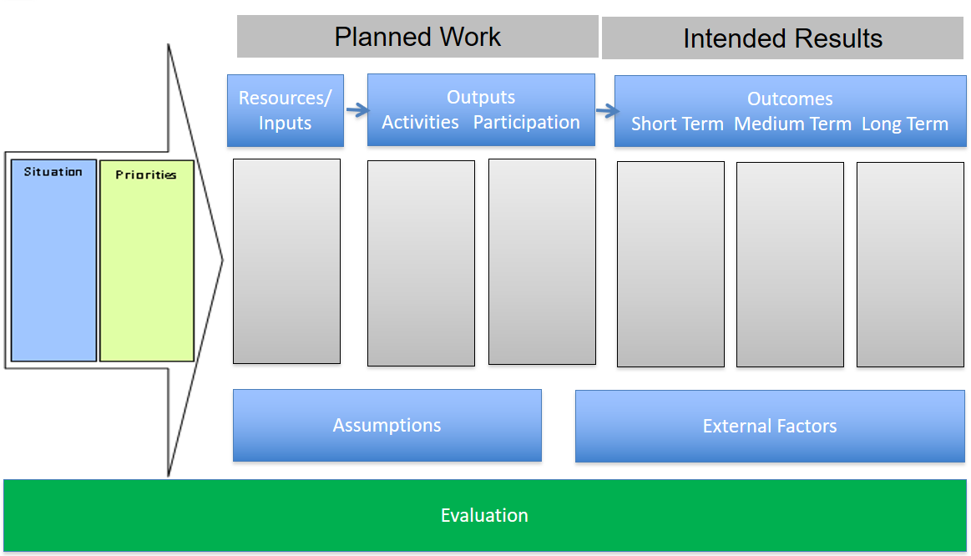
Template
Notes:
Emphasize the components of planned work and intended results.
Step 1: Begin with the Situation and Priorities:
Situation include: Needs and assets; Symptoms versus problems; Stakeholder Engagement
Priorities include: Mission, Vision, Values, Mandates, Resources, Collaborators, Competitors
Step 2: Develop your long-term outcome(s) What is the end result that you want to accomplish
Step 3: Develop the medium-term outcome(s)
Step 4: Short-term
Step 5: Participants
Step 6: Activities
Step 7: Resources/Inputs
Step 8: Assumptions and External Factors
Step 9: Evaluation

Slide 6
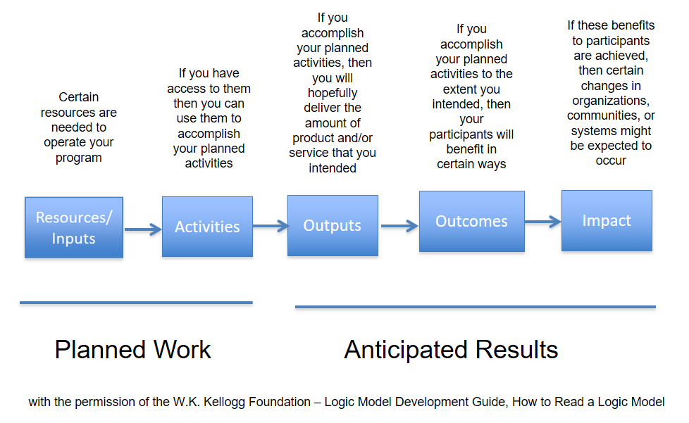
Reading a Logic Model

Slide 7
Situation
Define the importance of the issue?
Describe how the issue was identified?
Who do you expect to reach/involve in the project and what are their needs?
Are your program goals clearly identified and stated?
Who are the stakeholders and how will they be involved?

Slide 8
Priorities
Identify internal and external priorities that might impact the proposal.
Are there any collaborators that might be beneficial to you or the project?
Who are your known and/or suspected competitors and how might this influence your proposal?

Slide 9
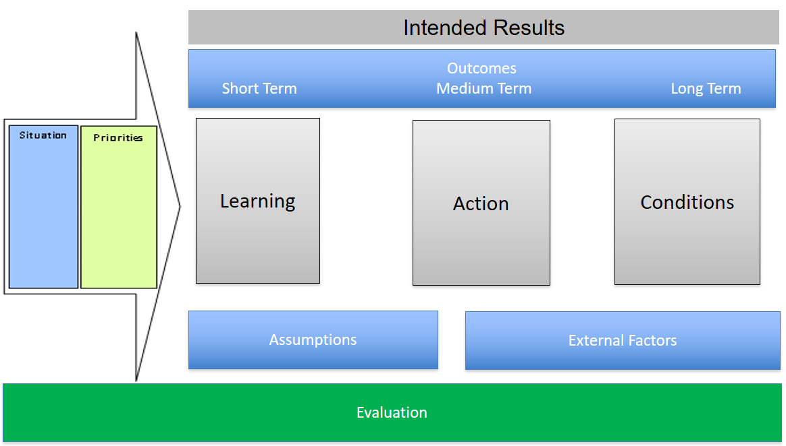
Outcomes
Notes:
Long Term – Conditions outcome(s): What is the expected lasting outcome? Does it align with the grantor’s expectation?
Medium Term – Action outcomes: Changes in behaviors, practices, policy, decision-making, social action.
Short Term – Learning outcomes: Awareness, knowledge, attitudes, skills, opinions, aspirations, motivations.
These each have different instruments to measure the effectiveness of your outputs. Measured outcomes should point toward the long term conditions/goals. Plan these carefully with an eye toward mid-term corrections and adjustments to your outputs.
Medium and short-term outcomes are results driven.
NOTE: THESE 3 COLUMNS ARE OFTEN MERGED INTO A SINGLE COLUMN OF OUTCOMES WHEN ADDING TO THE ACTUAL PROPOSAL APPLICATION

Slide 10
Planned Work - Resources
Enabling | Limiting
Funding | Attitudes
Facilities | Policies
Equipment | Regulations
Time | Geography
Supplies | Limited Enabling Resources
Partners
Networks
Notes:
In slide 5 we defined planned work and intended results. Here are some things to consider when working on the planned work section of the logic model.
What you think you need to implement your proposal.
What resources will either enable or limit your proposal’s effectiveness?
Enabling resources: funding, existing organizations, potential partners, existing organizational and interpersonal networks, staff, volunteers, time, facilities, equipment, supplies.
Limiting Resources: Attitudes, Lack of resources, policies, regulations, geography, facilities

Slide 11
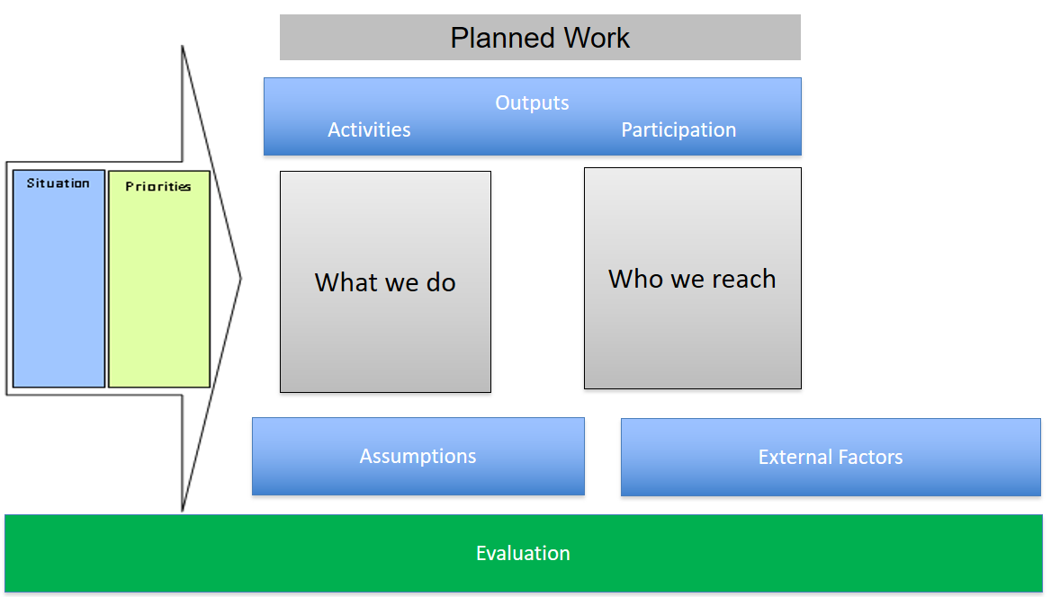
Outputs
Notes:
Activities are what we do: Workshops, meetings, services created, products developed, conduct training, facilitate activities, partnering, media and marketing
Participation is who we reach: participants, clients, agencies, customers, satisfaction with program from the participants.

Slide 12
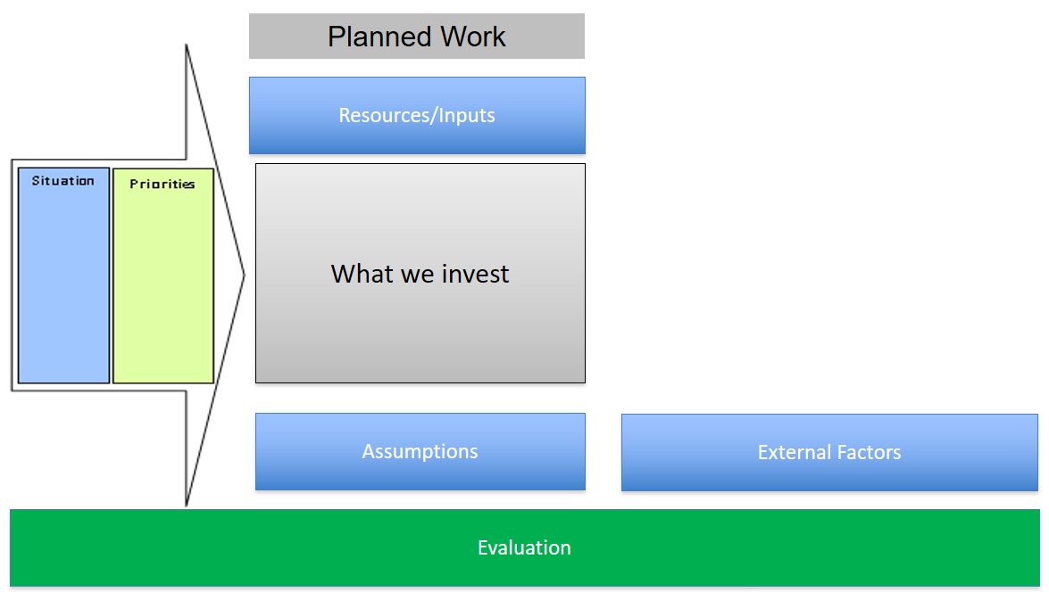
Inputs
Notes:
Staff, volunteers, time, money, research base, materials, equipment, technology, partners.
This is also a good place to determine what you can bring to the project and what you need the additional resources to provide.
Are there potential community partners that can collaborate with the project?
Can you leverage funds from Foundations or other philanthropic giving to support part of the project that can’t be funded by the grantor?

Slide 13
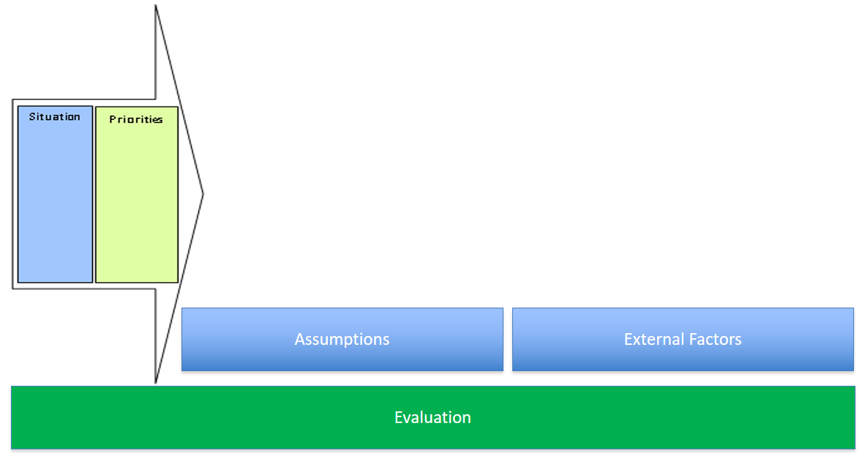
Assumptions & External Factors
Notes:
A logic model should include both assumptions and external factors

Slide 14
Assumptions & External Factors
Assumptions | External Factors
Beliefs | Aspects that influence or are influenced by the project
Ideas/biases | Cultural and environmental issues
What we expect the program to achieve | Demographics
Participant’s learning styles & behavior | Family circumstances
Resources and staff | Experiences of participants
External/Internal influences | Media, community policy, priorities
 | Competition

Slide 15
Evaluation Section
Program evaluation is necessary to determine:
  Effectiveness of program
  To meet grantor requirements
Logic Model provides:
  Information about what and when to measure
  Match evaluation to the program
  Focus on key and important information

Slide 16
Evaluation
Formative Evaluation – Improve | Summative Evaluation - Prove
Provides information that helps you improve your program. Generates periodic reports. Information can be shared quickly. | Generates information that can be used to demonstrate the results of your program to funders and your interested communities.
Focues most on program activities, outputs, and short-term outcomes for the purpose of monitoring progress and making mid-course corrections when needed. | Focuses most on program’s intermediate-term outcomes and impact. Although data may be collected throughout the program, the purpose is to determine the value and worth of a program based on results.
Helpful in bringing suggestions for improvement to the attention of staff. | Helpful in describing the quality and effectiveness of your program by documenting its impact on participants and the community.
Adapted from Bon, S.L., Boyd, S.E., & Montgomery, D.L. (1997 Taking Stock: A Practical Guide to Evaluating Your Own Programs, Chapel Hill N.C. Horizon Research Incop. Available online at http://www.Horizon-research.com
Notes:
Formative Evaluation – Helps improve you program
Summative Evaluation – Helps prove if your program worked the way you planned.

Slide 17
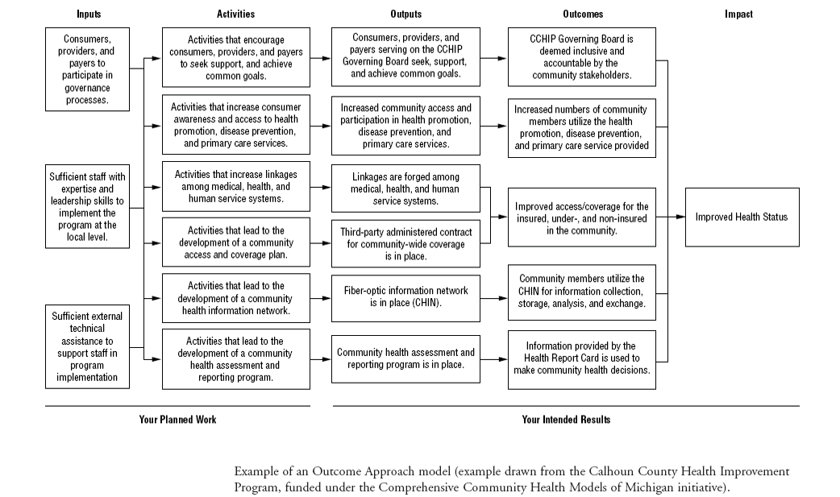
Sample Logic Model
with the permission of the W.K. Kellogg Foundation – Logic Model Development Guide, How to Read a Logic Model

